Slide 1

Capstone Project
On Hotel Booking
AI

Slide 2
INTRODUCTION
This data set contains booking information for a city hotel and a resort hotel.
Includes information such as when the booking was made, length of stay, the number of adults, children, and/or babies.
The number of available parking spaces, among other things.
(All personally identifying information has been removed from the data)

Slide 3
Data Summary
Data Set Name
Hotel Booking Database including booking information for a city hotel and a resort hotel of various countries from 2015 – 2017.
Shape
● Row - 119390
● Column - 32

Slide 4
Columns used
hotel - H1 city hotel, H2 Resort hotel
is_canceled - 1:Canceled, 0:Not canceled
Lead_time - Time between booking & arrival
Arrival_date_year - year of arrival date
Arrival_date_month - month of arrival date
Arrival_date_week_number – Week number of year for arrival date
Arrival_date_day_of_month – Day of arrival date
Stays_in_weekend_nights – stay in weekend nights

Slide 5
Columns used
Stays_in_week_nights - stays in week nights
adults – total number of adults in hotel
Children – total number of children in hotel
babies – total number of babies in hotel
Meal – Bed & Breakfast (BB), Half Board (HB), Full Board (FB), Undefined contain no meal package
Country – country of customers
Market segment – A group of people who share one or more common characteristics used for business
distribution_channel –Chain of business through which a service passes until it reaches the final buyer

Slide 6
Previous_cancellations – previous cancellation by customer
Previous_booking_not_canceled- confirmed booked by customer
reserved_room_type – Pre-booked by customers
assigned_room_type – single / couple / family
booking_charges – booking charges we charged
deposit_type – No Deposit, Non Refund, Refundable
agent- ID of travel agency
company- ID of the company
days_in_waiting_list – Number of days in waiting

Slide 7
Required_car_parking_space – required car parking space by the customer
Total_of_special_request – number of special request requested
reservation_status - Canceled, Check out
reservation_status_date – Canceled / check out
Is_repeated_guest – contain data of repeated guest
Customer_type – Contract / Group / Transient

Slide 8
The Past 5 Years…
High demand from leisure and business travelers and international tourists Revenue growth at average annual rate of 4.2% Demand for hotel rooms has outpaced supply, leading to higher room rates IBIS predicts strong growth in extended-stay hotels, boutique hotels, spa and health retreats and resorts. The industry has grown rapidly Increases in travel spending, corporate profit and consumer spending this lets suppliers charge more and operate with lower vacancy rates.

Slide 9
Problem statements
Have you ever wondered when the best time of year to book a hotel room is? Or the optimal length of stay in order to get the best daily rate?
What if you wanted to predict whether or not a hotel was likely to receive a disproportionately high number of special requests?
This hotel booking dataset can help you explore those questions!

Slide 10
Table of Contents
● Cancellation status
● Special Requests
● Booking ratio between Resort & City hotel
● Number of people who booked the hotel
● Country origin of most guests
● Booking per year
● Busiest month for hotels
● Meal Type

Slide 11
Number of Travellers in various month
Room Type
Repeated Guest
Reservation Status
Weekends vs Weekdays
Checking Travellers
Booking
Satisfactory of Customers
Challenges
Conclusion

Slide 12
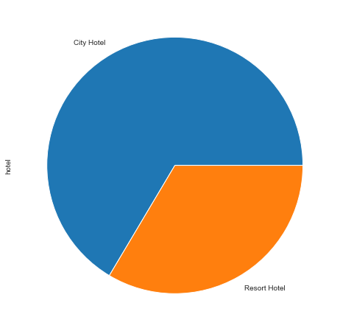
Booking status
● Majority of the booked Hotel is City Hotel than Resort Hotel.

Slide 13
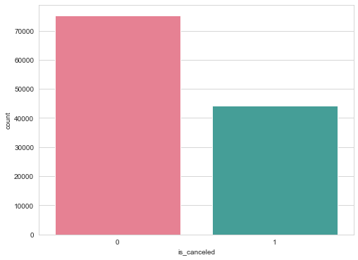
HOW MANY BOOKING WERE CANCELLED?
● During the year we have 37% of cancelations.

Slide 14
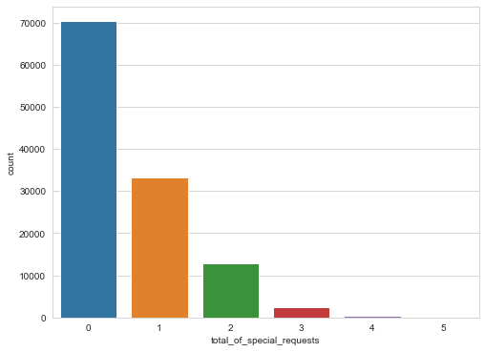
Special requests
● As we can see here among all one special booking request were made almost 27% of total bookings.
● Two special request were made nearly 10% among all and 3 special request is nearly 2%.

Slide 15
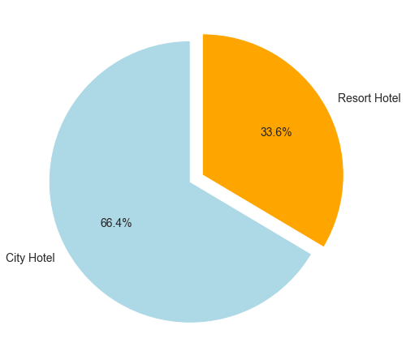
Booking ratio between Resort & City hotel
What do we see here?
● It seems that a huge proportion of hotels was city hotel.
● Resort hotel tend to be on the expensive side and most people will just
stick with city hotel. Also, resort hotels tend to be appropriate for larger group of people.

Slide 16
The number of people who booked the hotel
● Looking into adults
Hotels | Count
City hotel | 79330.0
Resort hotel | 40060.0
● Looking into children
Hotels | Count
City hotel | 79330.0
Resort hotel | 40060.0
● It seems that mean values for adults and children are higher.
● This means that resort hotels are better choice for large families.

Slide 17
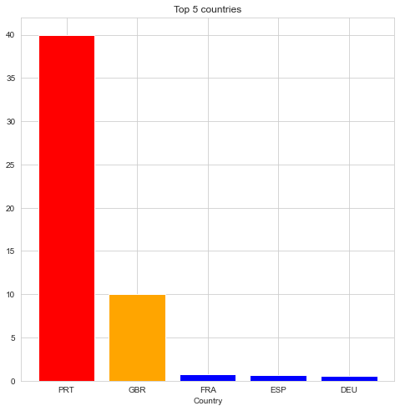
Country origin of most guests
● As we can see, Portugal tops the list with 40.69% of the guests.
● The European countries tops the table, seems like they are more interested in traveling as compare to others country.

Slide 18
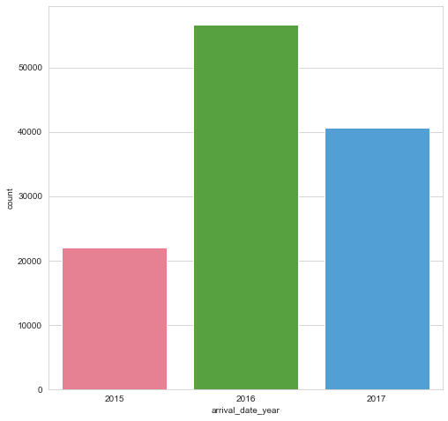
Booking per year
● There has been many arrivals in the year 2016 than the remaining years.
● We can also say that there has been increase in the arrivals as years passes.

Slide 19
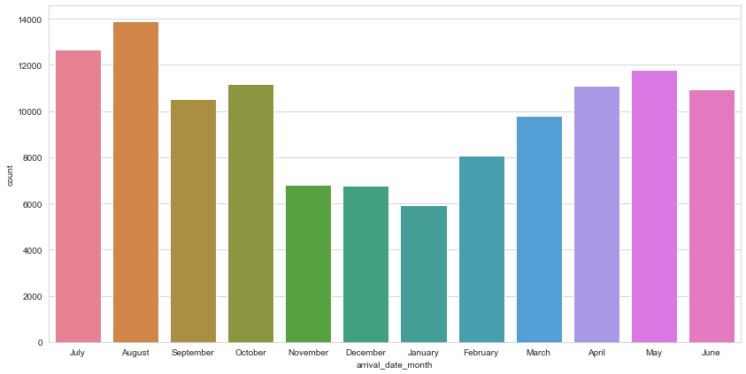
Busiest month for hotels
● The Busiest month for hotel is August with 11.62% of the reservations.
● The month of least occupation is January with 4.96% of the reservations.

Slide 20
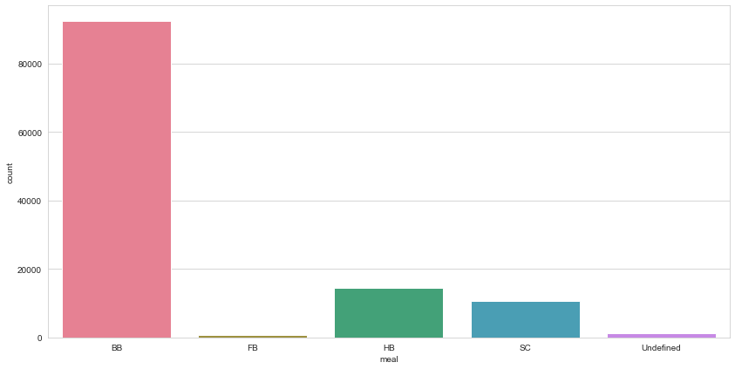
Meal Type
● The most eaten meal is BB with the count 80000.
● The least eaten meal is FB with count below 100.

Slide 21
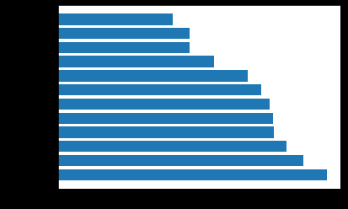
Number of Travellers in Various Months
January
December
November
February
March
September
June
April
October
May
July
August
0
2000
4000
6000
8000
10000
12000
14000
● The maximum number of people Travelled in August.
● The minimum number of people Travelled in January.

Slide 22
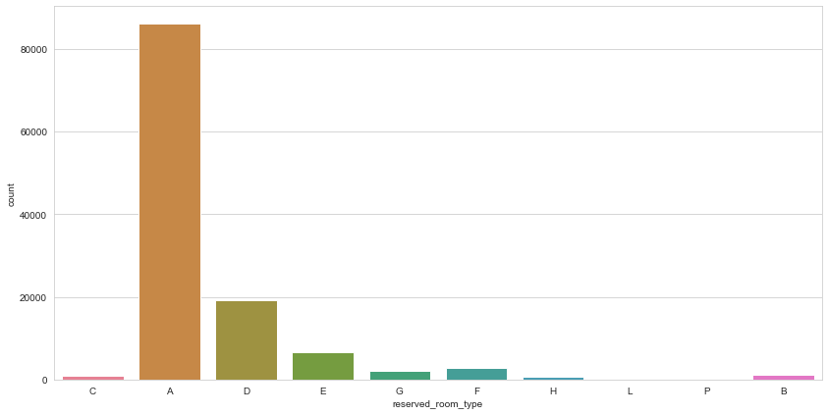
Room Type
● The Room Type “A” is selected by people almost everytime.

Slide 23
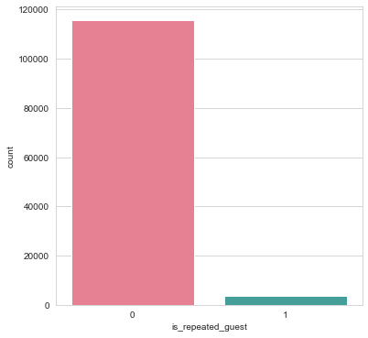
Repeated Guest
● The Repetition of a particular guest is seems to be very rare.

Slide 24
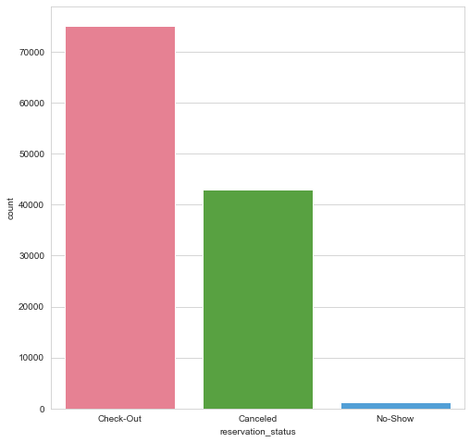
Reservation Status
● The cancelation of reservation is seems to be 50% which is very high.

Slide 25

Room Types
80000
60000
40000
20000
0
single
couple
family
● Clearly Majority of the rooms booked are couple rooms.

Slide 26
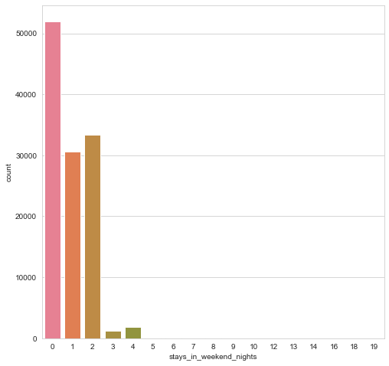
Average stays on weekends
● PEOPLE GENERALLY PREFER LONG STAYS ON WEEKDAYS RATHER THAN WEEKENDS.
● The count for booking on weekdays is higher than that of weekends with more than 50000.

Slide 27
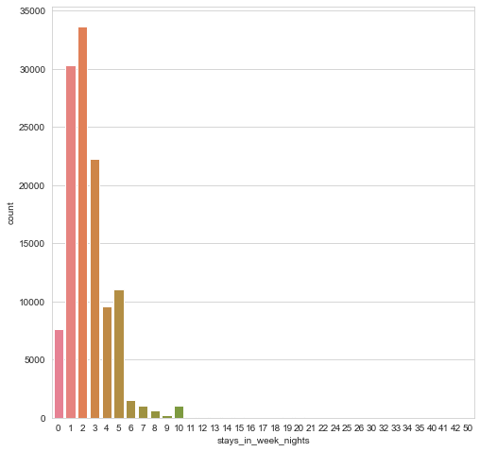
Average stays on Weekdays
● People in weekdays prefer to stay for 1-3 days.
● People stays on weekdays is more than that of weekdays.

Slide 28
Checking details
Checking the travelers without children
13 | 1
45 | 2
55 | 3
. . | . .
119298 | 2
119318 | 1
119319 | 2
● There are around 23,0027 rooms booked as single room

Slide 29
Checking the travelers without babies
0 | 118473
1 | 900
2 | 15
10 | 1
9 | 1

Slide 30
Checking the adult traveler count
2 | 89680
1 | 23027
3 | 6202
4 | 62
26 | 5
10 | 1
6 | 1
● There are around 89,680 room booked as couple room
● There are around 6683 room booked as family room

Slide 31

Booking
50000
40000
30000
20000
10000
0
Online Booking
Offline Booking
● Majority of the customers book through online rather than offline booking

Slide 32

Satisfactory of customers
80000
60000
40000
20000
10000
0
Satisfied
Change of Room
● Majority of the customers has got the room type they have booked

Slide 33
Challenges
Lots of column to work on takes lot of time to identify which column to select to start with.
Lots of NaN values in data set.
Needed to import few Library manually like for country identification.

Slide 34
conclusion
During Summer Season the hotels are expected to get more no of bookings than any other seasons. So, if You want to enjoy privacy You can book in remaining seasons.
Majority of the Bookings happen through online as it is very easy and efficient way.
We can clearly see the average stay is between 1-3 days we must try to extend the duration as there is high chance to get attractive deals from the hotels.

Slide 35


